Slide 1
Cause of Death
Data Analysis

Slide 2
Problem Statement
Around 58 million people die each year worldwide.
What caused their death?
How did the causes of death change over time and differ between different countries and world regions?
These are the big questions we are answering here by analysing the given dataset.

Slide 3
About the dataset
The dataset contains 6120 observations with 34 columns in each observation
The above dataset contains 30 years data of 204 countries.
The key features of this Dataset are: Meningitis, Alzheimer's Disease and Other Dementias, Parkinson's Disease, Nutritional Deficiencies, Malaria, Drowning, Interpersonal Violence, Maternal Disorders, HIV/AIDS, Drug Use Disorders, Tuberculosis, Cardiovascular Diseases, Lower Respiratory Infections, Neonatal Disorders, Alcohol Use Disorders, Self-harm, Exposure to Forces of Nature, Diarrheal Diseases, Environmental Heat and Cold Exposure, Neoplasms, Conflict and Terrorism, Diabetes Mellitus, Chronic Kidney Disease, Poisonings, Protein-Energy Malnutrition, Road Injuries, Chronic Respiratory Diseases, Cirrhosis and Other Chronic Liver Diseases, Digestive Diseases, Fire, Heat, and Hot Substances, Acute Hepatitis.

Slide 4
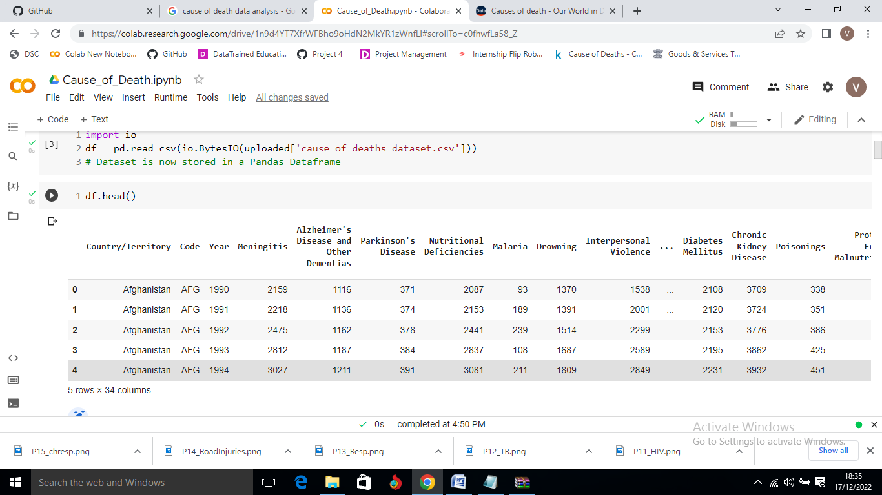
Dataset

Slide 5

Top 40 Deaths worldwide
From the Above table, the "top 40 - Total_no_of_Deaths" belongs to 'China' and 'India' because of the fact "China" and "India" are the most populated countries of the World

Slide 6
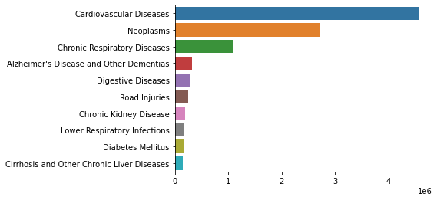
Top 10 causes of death in China

Slide 7
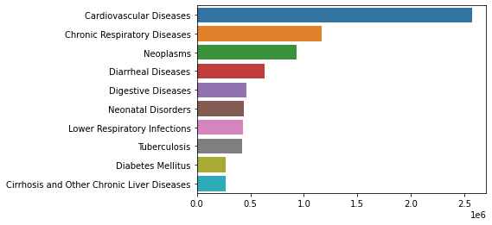
Top 10 causes of death in India

Slide 8
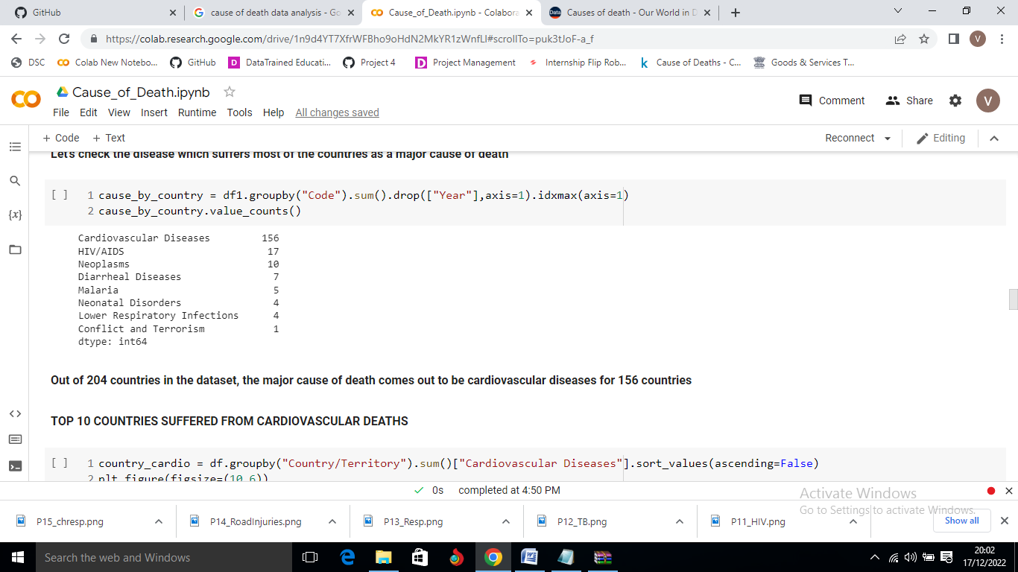
Which disease is the major cause of death ?
Out of 204 countries in the dataset, cardiovascular diseases are a major cause of death for 156 countries

Slide 9
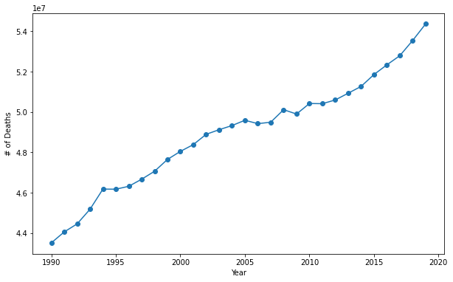
Which year is the deadliest?
Deadliest year appears to be 2019 in terms of death counts; however it was due to the increase of the world population each year.

Slide 10
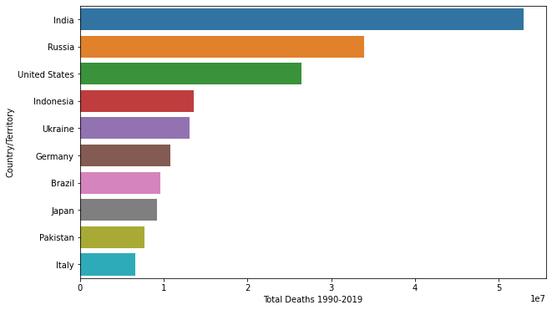
Which country suffered most from CVD ?
India has highest number of deaths due to cardiovascular diseases followed by Russia and US

Slide 11
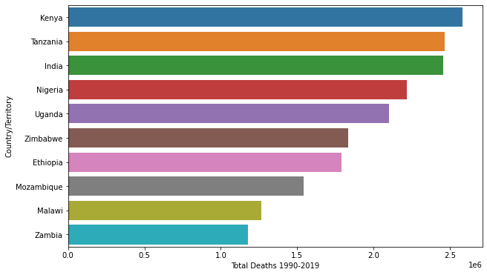
Which country suffered most from HIV/AIDS ?
Across Sub-Saharan Africa the deaths are much higher. Most countries in the South of the region had deaths greater than 1.5 million. In India, the deaths due to HIV/AIDS were nearly 2.5 million.

Slide 12
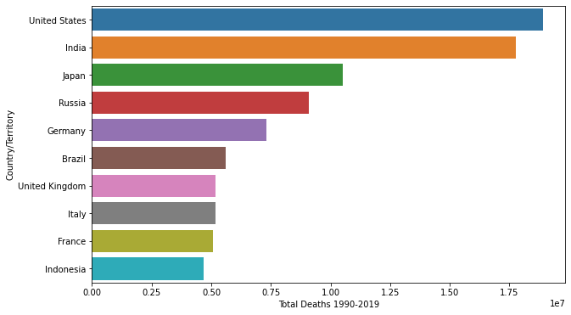
Which country suffered most from Neoplasm ?
Cancer is a particularly common cause of death in richer countries where people are less likely to die of infectious diseases and causes of deaths that lead to very early deaths for people in poverty.

Slide 13
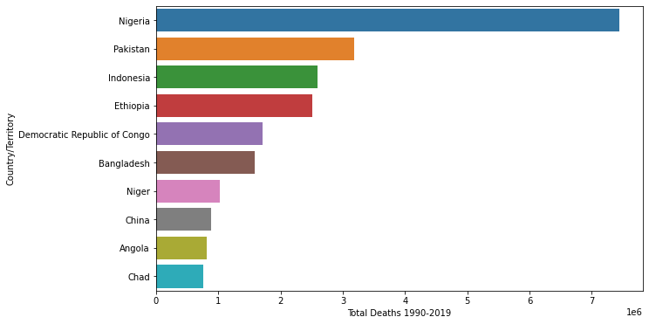
Which country suffered most from Diarrheal Diseases ?
Diarrheal diseases were the fourth leading cause of death in 2019.
Overall, we see the highest mortality in Sub-Saharan Africa and South Asia.

Slide 14
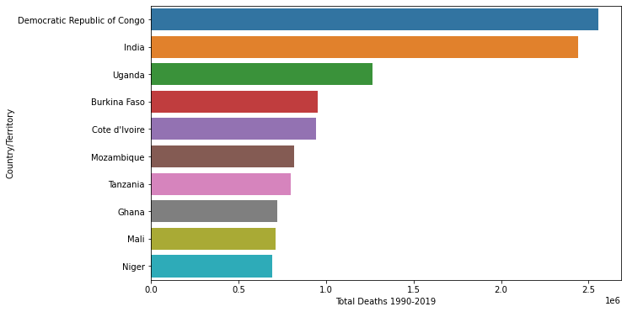
Which country suffered most from Malaria ?
Africa is the world region that is most affected by malaria in the last 30 years

Slide 15
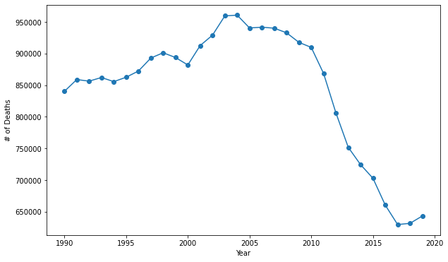
Which year suffered more deaths due to Malaria?
Majority of global deaths from malaria occurred on the African continent. But Africa is also the world region that has achieved most progress: since 2000, deaths have fallen significantly

Slide 16
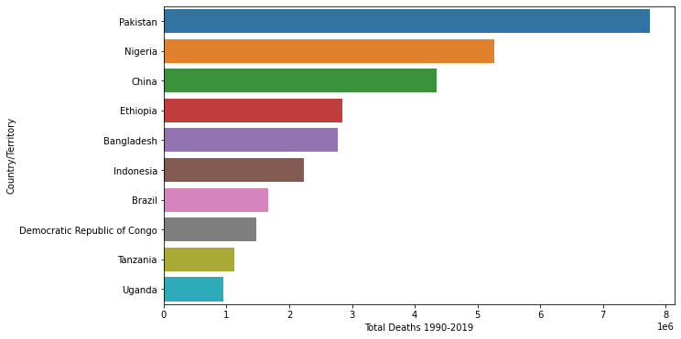
Which country suffered most from Neonatal disorders?
The highest mortality are seen across Sub-Saharan Africa and Asia

Slide 17
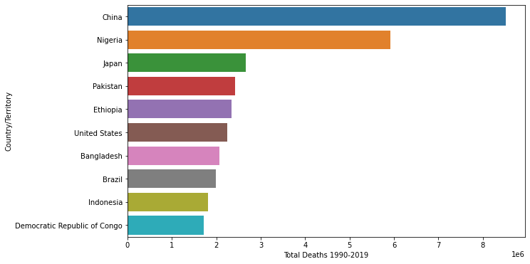
Which country suffered most from Lower Respiratory Infection?
China has highest number of deaths due to lower respiratory infections like Pneumonia
USA also in top 6 in number of deaths due to lower respiratory infections

Slide 18
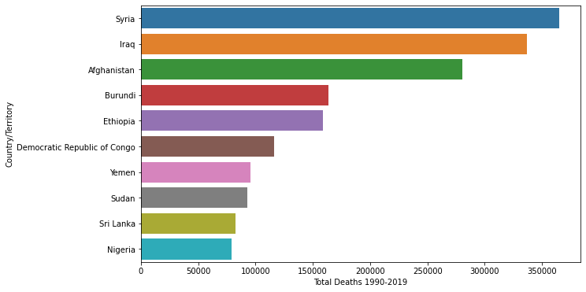
Which country suffered most Conflict & Terrorism ?
Most victims of terrorism die in the Middle East, Africa, and South Asia
Most are affiliated with well-known terrorist groups, such as Islamic State, Taliban, Boko Haram, and Al-Shabaab

Slide 19
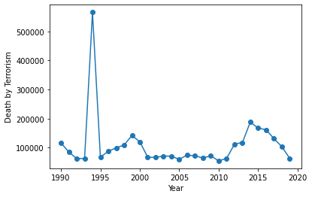
Which year see max death due to Conflict & Terrorism ?
1994 was the year where the deadliest conflicts took place in the world. Bosnian War in Europe may have contributed to it significantly
After 2014, deaths due to conflicts and terrorism has been decreasing which is a good sign for the world

Slide 20
Conclusion
Causes of death vary significantly between countries: non-communicable diseases dominate in rich countries, whereas infectious diseases remain high at lower incomes.
Non-communicable diseases (NCDs) not only dominate mortality figures at a global level, but also account for the majority of deaths in high-income countries.

